Slide 1


Slide 2
Database Application Development
Objectives:
ស្វែងយល់ពី មូលដ្ឋានសំរាប់អភិវឌ្ឍប្រព័ន្ធ CLIENT/SERVER AND DB SERVER។
DATABASE SERVER AND DB API.
ផ្តល់ផ្លូវដើរមួយសំរាប់អភិវឌ្ឍន៍ប្រព័ន្ធ ក្នុងរបៀបជាអ្នកសរសេរកម្មវិធីអាជីព។

Slide 3
INTRODUCTION
DATABASE APPLICATION System is a customized computer program to enter and retrieve data/information from a database.
Database Application System is a core of Business information system. It’s a tool/mean for
Perform business operation.
Report generator for management team.

Slide 4
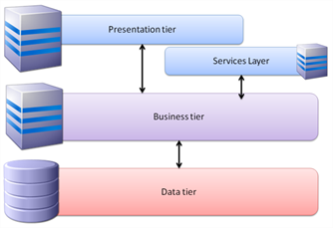
System’s Tier(Layer):
Presentation Layer: Form/Report for in/out put.
Business Layer: Business requirement and rule for transaction and query.
Data Store Layer: Database files for storing business’s data.

Slide 5
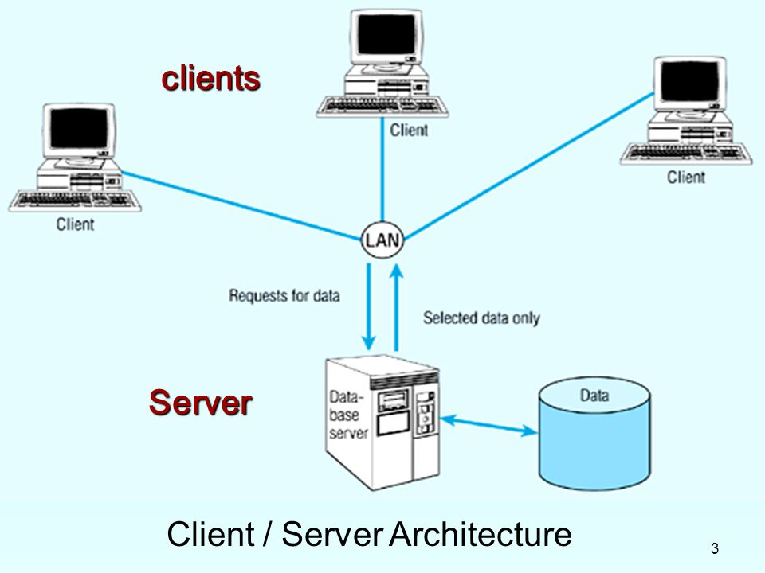
CLIENT/SERVER DATABASE
DATABASE SERVER IS A DATABASE THAT CLIENT ACCESS TO DATABASE FILE THROUGH SERVER INSTANCE.

Slide 6
CLIENT/SEVER SYSTEM MODEL.
FAT(THICK) VS THIN CLIENT/SEVER
2 TIERS VS 3 TIERS CLIENT/SERVER
DISTRIBUTED SYSTEM

Slide 7
SQL SERVER CONCEPT.
IS A DATABASE SERVER of Microsoft. SQL Server is similar to Sybase.
INSTALLATION:(Option)
DATABASE ENGINE/CLIENT TOOL
INSTANCE
SECURITY AUTHENTION TYPES
LOG ON TYPE
(DEMO)

Slide 8
SQL SERVER CONCEPT(CON…)
SQL SERVER Database’s object.
Data components:
Table, View, Diagram
Business’s logic components:
Procedure, Function and Trigger

Slide 9
SQL SERVER CONCEPT(CON…)
SQL SERVER DATA TYPES:
- TEXT: ASCII: CHAR,VARCHAR
UNICODE: NCHAR,NVARCHAR (Select collation(character set))
Text
NUMBER
DATE/DATE TIME
BINARY/VARBINARY
IMAGE
(DEMO)

Slide 10
T-SQL CONCEPT
T-SQL is server programming language by adding procedural programming feature on standard SQL.
Procedural Language feature
SQL
DML
DDL
DCL
Program structure
VARIABLE DEFINITION
AND ASSIGMENT
CONTROL STRUCTURE

Slide 11
T-SQL (CONT..)
DECLARE
Declare @varname datatype
All variable is contains @, except cursor type.
Example
declare @code varchar(20),@name nvarchar(100)
declare @price numeric(18,2)

Slide 12
T-SQL (CONT..)
ASSIGN VALUE
Syntax 1: Set @varname=expression
Syntax 2: Select @varname=expression/fieldname,….. [From table/view [where condition]]
Example:
set @code=‘P1’
select @name=ItemName,@price=UnitPrice from tblItems where code=@code

Slide 13
T-SQL (CONT..)
CONTROL STRUCTURE
1. If (Condition)
statement
[else
statement]
2. While(Condition)
Statement.
to group/block statements use
begin
…..
end.

Slide 14
T-SQL (CONT..)
CASE EXPRESSION
To switch value(change value)
1. Switch one to one value:
Case expression
when val1 then changetoval1
when val2 then changetoval2
…..
[else
ValN ]end
2. Switch one condition(set of value meet a condition) to one value:
Case when Condition1 then changetoval1
When Condition2 then changetoval2
…..
[else
ValN ] end.

Slide 15
T-SQL (CONT..)
Example:
Suppose we have table
Students(Code,Name,Sex,Dept,Province)
Score(ACYear,Code,Subject,Score)
Grading student.
Select AcYear,Code,Avg(Scode) as Average,
Case When Avg(Scode)<50 then ‘Poor’
Case When Avg(Score)<60 Then ‘Average’,
Case When Avg(Score)<80 Then ‘Faire’
else ‘Good’ end as
from Score
Group by AcYear,Code
Select AcYear,Code,Sum(Case Subject When 'Java' Then Score else 0 end )Java,
Sum(Case Subject When 'Network' Then Score else 0 end )Network,Sum(Case Subject When 'ISA' Then Score else 0 end) ISA,AVG(Score) as Average
from Score
group by AcYear,Code

Slide 16
T-SQL (CONT..)
SUB PROGRAM: there are 3 types
Store procedure: is sub or void method
Syntax:
Create Proc ProcName(par_list) as
Begin
T-SQL statement
End
Store function: returns value/table
Syntax:
Create function funName(par_list) returns scalartype/Table
Begin
T-SQL statement
return value/records
End

Slide 17
T-SQL (CONT..)
Trigger: is special procedure that bind with table transaction and auto execute(run) when bound table received transaction.
Create trigger triggerName on TableName for TransactionName as
Begin
T-sql statement.
End.
To collect data from transaction we use “INSERTED” and “DELETED” virtual table.

Slide 18
T-SQL Cont
Cursor
Is a data type where it variable store address of rows(records) return from Select Statement. Syntax and use
Step 1 Declare
DECLARE cursor_name CURSOR [ FORWARD_ONLY | SCROLL ] [ STATIC | KEYSET | DYNAMIC FOR select_statement
Step 2 Open
Open CurName
Step 3 Read data and process
Fetch first from curName into @var1,@var2,….
while(@@fetch_status<>0)
Begin
Process_Logic
Fetch Next from curName into @var1,@var2,….
End
Step 4: close and Clear
Close CurName
Deallocate CurName

Slide 19
Database API
Is a tool set provide object to work to database.
Example: DAO,RDO,ADO,ADO.NET,JDBC,OO4O,……
ADO.NET’s Object:
Connection: for connecting to a database it’s representative of a database in application program environment.
Command: Packaging SQL Command for transfer to execute in DB then return data if it’s select statement.
DataReader: Store rows return Command(Select) Object.
Transaction: For controlling transaction.
DataAdapter: Similar to Command but run is disconnected mode
CommandBuilder: Assistant of DataAdapter for making transaction
DataTable: Temporary table in disconnection mode.
DataSet: Set of DataTable

Slide 20
Steps of making transaction to database
Step1: Make Connection
sqlClient.sqlConnection cn=new sqlClient.sqlConnection() ;//C#
Cn.ConnectionString=“Server=ServerName;Database=DBName;User ID=username;Password=password”;
Cn.Open();
Step2: Make Transaction
sqlClient.sqlTransaction t;
t=cn.begintransaction();
try{
sqlClient.sqlCommand cmd1=new sqlClient.sqlCommand(“Non-Select SQL’,cn,t);
cmd1.executeNonQuery();
sqlClient.sqlCommand cmd2=new sqlClient.sqlCommand(“Non-Select SQL’,cn,t);
cmd2.executeNonQuery();
….
t.commit();
}
catch(Exception e){ t.rollabck();}

